Slide 1


Slide 2
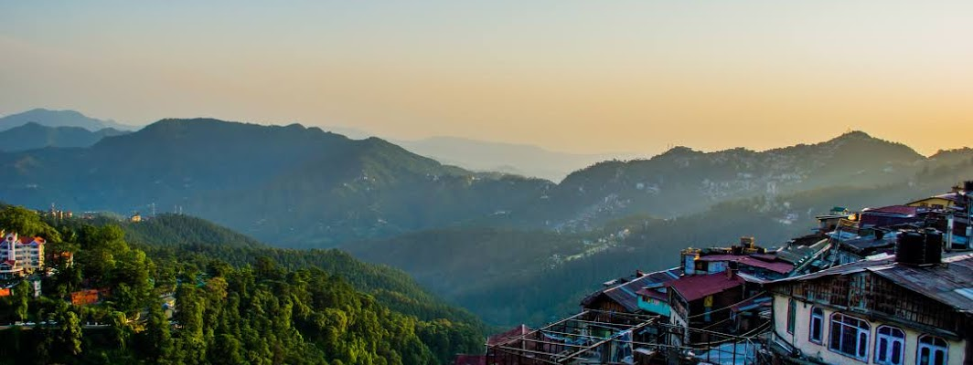


Introduction
Shimla
Shimla is the capital of the northern Indian state of Himachal Pradesh, in the Himalayan foothills. Once the summer capital of British India, it remains the terminus of the narrow-gauge Kalka-Shimla Railway, completed in 1903.

Slide 3

Our Sponser

Slide 4
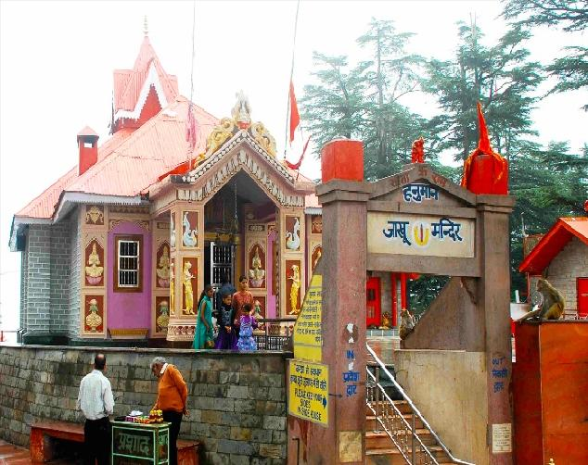
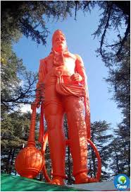

Jakhoo Temple(Shimla)
Jakhoo Temple is an ancient temple in Shimla, dedicated to Hindu deity, Hanuman. It is situated on Jakhoo Hill, 2.5 km /1.3 miles east from the Ridge, Shimla at .

Slide 5
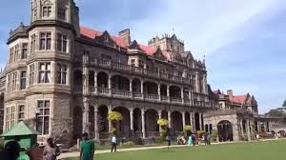
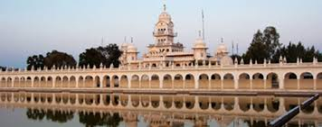
Rashtrapati Niwas (Shimla)
The Rashtrapati niwas, also known as viceregal lodge, is located on the Observatory Hills of shimla, Himachal pradesh, india. It was formerly the residence of the British viceroy of india.

Slide 6

Our Sponser

Slide 7
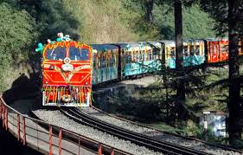
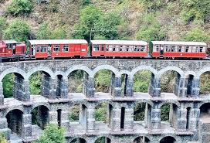
Kalka Train(Shimla)
Kalka–Shimla Railway
The Kalka–Shimla Railway is a 2 ft 6 in narrow gauge railway in North-West India travelling along a mostly mountainous route from Kalka to Shimla. It is known for dramatic views of the hills

Slide 8
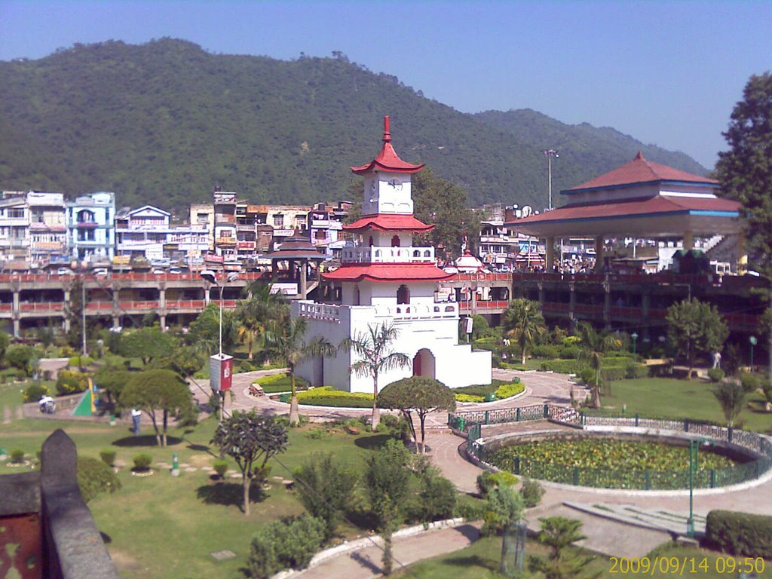
Mandi
Mandi
Mandi district (earlier known as Mandavya Nagar) is one of the central districts of Himachal Pradesh state

Slide 9


Our Sponser

Slide 10
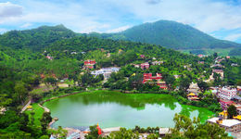

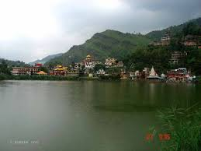
Rewalsar Lake (Mandi)
Rewalsar Lake, or Tso Pema Lotus Lake, is a mid-altitude lake located on a mountain spur in Mandi district, 22.5 km south-west from Mandi. Its elevation is about 1,360 m above sea level.

Slide 11
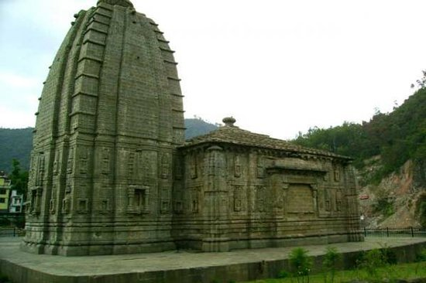

Panchavaktra temple(Mandi)
Located at the convergence of Beas and Suketi rivers, Panchavaktra temple has Lord Shiva as the presiding deity. The idol of Lord Shiva has five faces. The temple serves as a fine example of Shikhara style of architecture. The temple has been declared as a National Heritage Site.

Slide 12

Our Sponser

Slide 13
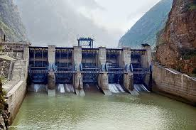
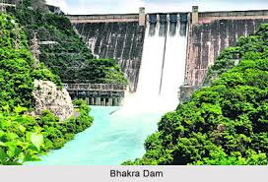
Pandoh Dam(Mandi)
The Pandoh Dam is an embankment dam on the Beas River in Mandi district of Himachal Pradesh, India. Under the Beas Project, the dam was completed in 1977 and its primary purpose is hydroelectric power generation

Slide 14
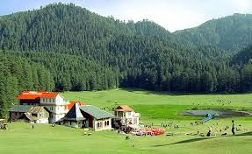
Chamba
The towns of Dalhousie and Khajjhiar are popular hill stations and vacation spots for the people from the plains of northern India. Chamba is the only district in northern India to preserve a well-documented history from c. 500 AD.

Slide 15


Our Sponser

Slide 16
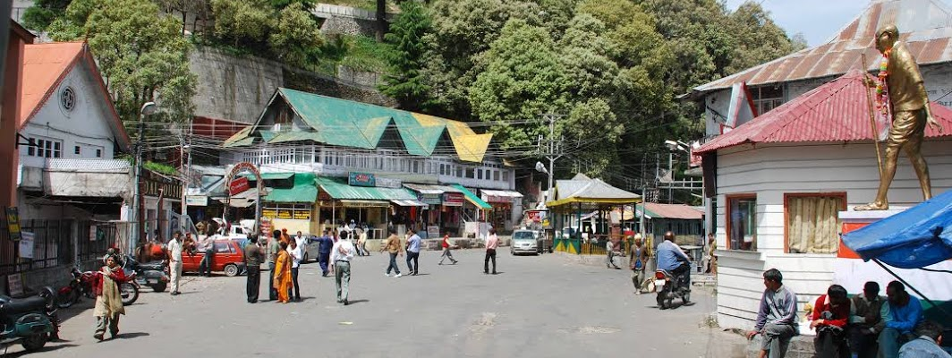
Dalhousie (Chamba)
Dalhousie is a hill station in Chamba district, in the northern state of Himachal Pradesh, India. It is situated on 5 hills and has an elevation of 1,970 metres above sea level.

Slide 17

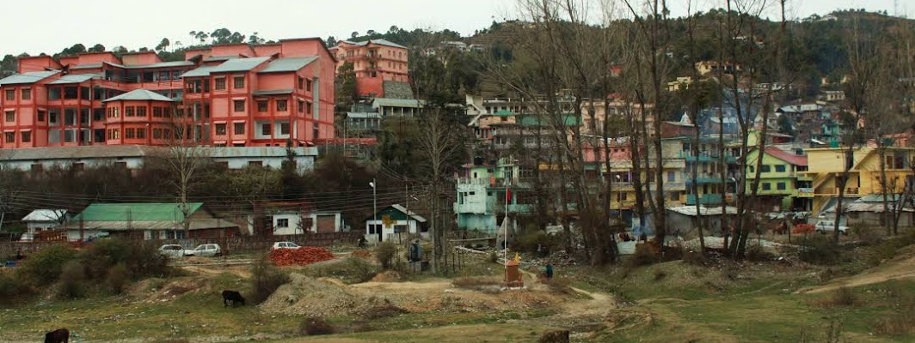
Banikhet (Chamba)
Banikhet is located about seven kilometers from Dalhousie, India. Banikhet is an important place in Chamba district tourism. It is also known as the gateway of Chamba district. Transport is available for all major and minor tourist spots. Accommodation at low rates is also available. It is also known for the Historical Naag Mandir, Jawala Mata Mandir and Helipad

Slide 18

Our Sponser

Slide 19
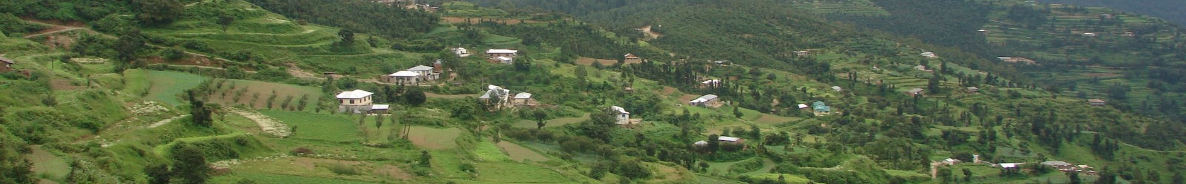
Hamirpur
Hamirpur (Hindi|हमीरपुर) is a town and the district headquarters of Hamirpur district in the Himalayan state of Himachal Pradesh, India. Hamirpur is located in a relatively colder region in western Himachal Pradesh with a lower altitude as compared to the other districts of the state.

Slide 20
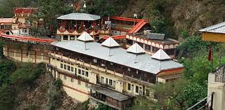
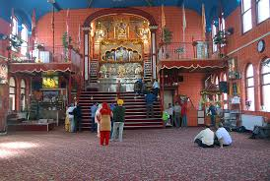
Deotsidh Temple Hamirpur, Himachal
Situated on the border of Hamirpur and Bilaspur, Deotsidh Temple is amongst the most popular shrines in Hamirpur district. Deotsidh is a cave temple that is dedicated to Baba Balaknath. It is believed that the sage meditated here. Baba Balak Nath was a spiritual reformer during the time of Shakti movement and is appreciated for his acts of philanthropy. The Deotsidh temple is inaccessible; however, they can see the deity from a raised platform located in front of the cave temple.

Slide 21

Our Sponser

Slide 22

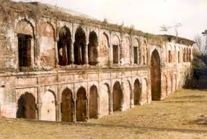
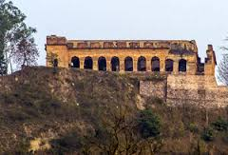
Sujanpur Tira Fort Hamirpur
The palace-fort, Sujanpur Tira is situated at a distance of 22kms from Hamirpur town and touches the Kangra border. The fort was built by Raja Abhay Chand of the Katoch dynasty of Kangra in 1758. For more than a century, Sujanpur Tira remained the royal residence for the Katoch dynasty. The fort in the early 19th century was also the residence of Raja Sansar Chand, who is reckoned to be the patron of Kangra School of miniature paintings.

Slide 23
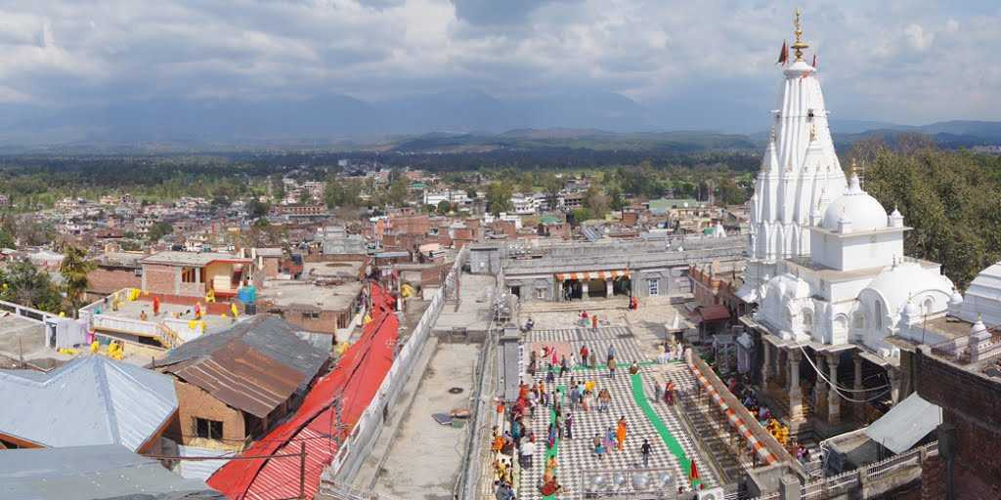
Introduction
Kangra
Kangra
Kangra is a composite word made out of Kaann (meaning ear) + gaddha (create/mold). This name was given to Kangra because of the famous ancient plastic surgeons of the region who were known to provide plastic surgery for royals who wanted to improve their looks and warriors who had lost facial features during wars

Slide 24

Our Sponser

Slide 25

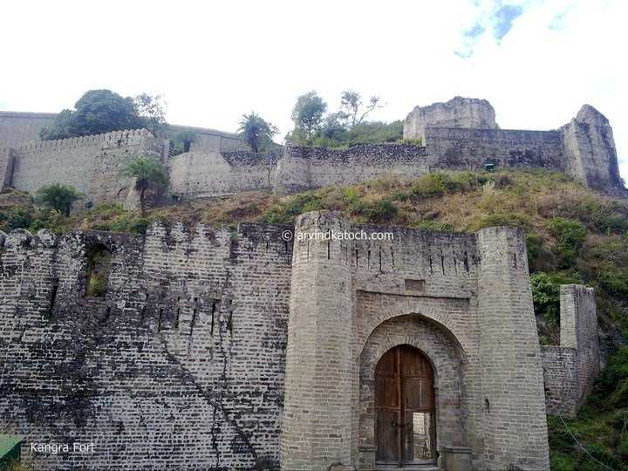
Kangra Fort
Kangra, the land of ancient Trigarta, occupying the lower valley of the Beas and its tributaries, was in ancient times, one of the leading hill stations of Punjab and Himachal. With numerous names who've said to have held the ownership of the Fort, it has got quite some history in its account. With many years of Mughal ownership and at the last being ruled by an Indian emperor, this place is a must-visit for any history enthusiast

Slide 26
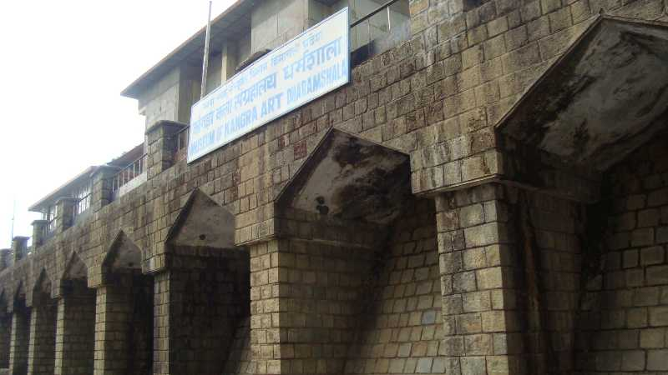
Kangra Art Museum
The Kangra Museum is dedicated to the brilliant marvels of Tibetan and Buddhist artwork and their rich history. Among the large variety of its precious collectibles are jewelry, rare coin memorabilia, paintings, sculptures and pottery.

Slide 27

Our Sponser

Slide 28
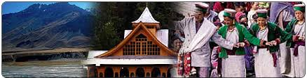
Introduction
Una
Una is one of the districts of Himachal Pradesh, India, and shares its border with the Hoshiarpur District and ropar district of Punjab. The terrain is generally a plain with low hills. Una has been identified as a main industrial hub and has become a transit town for travellers going to the famous city of Dharamshala or locations within the Himalayas such as Kullu, Manali, Jawalamukhi, and Chintpurni.

Slide 29
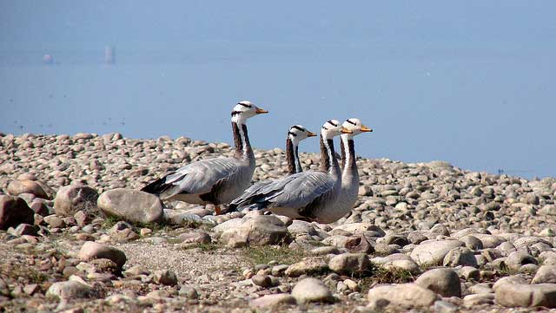
Pong Dam (Una)
Constructed across the river Beas, the Pong Dam is one of the most famous attractions in Una. The area is located 450 meters above sea level and is also home to a Wildlife sanctuary which contains a huge number of bird species and animal species like leopard, deer, sambar and wild boars. The place is great for a picnic and photography due to the several birds that can be spotted

Slide 30

Our Sponser

Slide 31

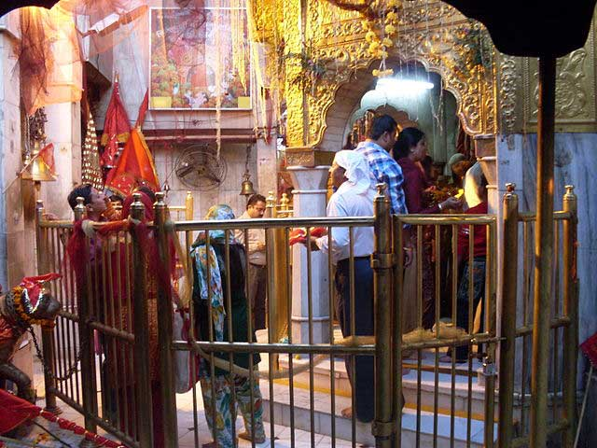
Chintpurni Temple (Chhinnamastika Devi Temple)
Chintpurni temple is considered as one of the most important of the 51 Shakti Peetha in India. The forehead of the Goddess Sati is believed to have fallen at this place. The temple is situated at an elevation of 950 meters above sea level and is dedicated to the Hindu deity Maa Chandi or Chinnamastika.

Slide 32
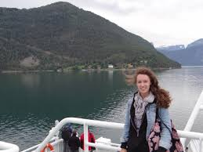
Kasauli (Solan)
Less than an hour away from Solan, is the quiet and calm town of Kasauli. With Pine trees and hills all around, Kasauli is the perfect getaway from Solan, with just the right amount of hustle and bustle and down its Mall road.

Slide 33

Our Sponser

Slide 34
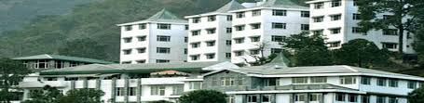
Introduction
Solan
The District is bounded by Shimla district in the North and by Ropar District of Punjab and Ambala district of Harayana in the south, by Sirmaur District in the east and by Bilaspur district in the west. Mandi District touches the boundary of Solan district in norht-east. The shape of the district is rectangualar with slight bulge on the northern side intruding towards Mandi district.

Slide 35
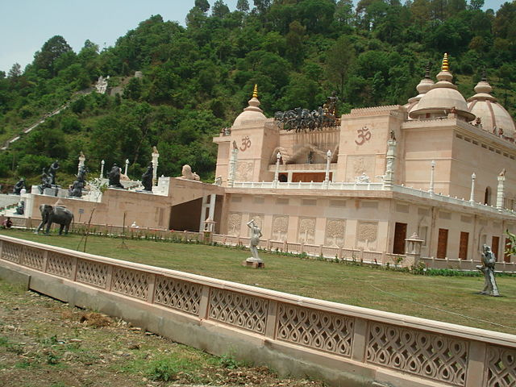
Mohan Shakti National Park
Located on the foothills of the Himalayas, Mohan Shakti National Park is one of the most picturesque picnic spots you’ll visit in Himachal Pradesh. The Park is situated amidst thick oak trees and terraced gardens. Being situated on the foot hills, the park offers some amazing and breathtaking views of the surrounding mountains.

Slide 36

Our Sponser

Slide 37
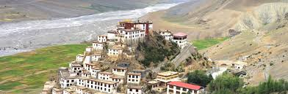
Introduction
Kinnaur
The tract of Kinnaur district due to great variation in its elevation, climate and topography represents varied fauna and flaura. For the reasons for their ecological, faunal, floral and geomophilogical importance three wild life sanctuaries are set up in the district. The min objective of these are to save the rare species. Varied varieties of wildlife can be seen in these sanctuaries

Slide 38
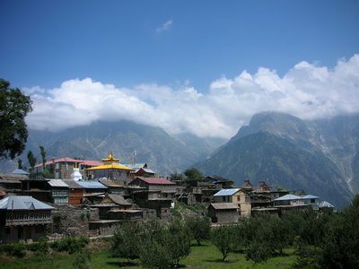
Kalpa(Kinnaur)
Kalpa is situated at an altitude of 2759 m from the sea level, on the old Hindustan Tibet Road at a distance of 260 km from Shimla. Earlier it was the District Headquarter of Kinnaur. It is 14 kms. and half an hour's drive from District Headquarter Reckong Peo. It has all the characteristics of a heritage village.

Slide 39

Our Sponsers

Slide 40
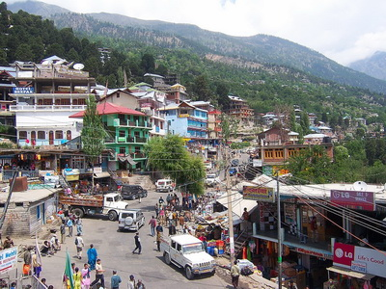
Reckong Peo(Kinnaur)
 | Reckong Peo is situated at an altitude of 2670 m from the sea level, located 235 km from Shimla. It is the District Headquarter having a panoramic view of Kinner Kailash. Kinner Kailash mountain is regarded as one of the mythical homes of Lord Shiva, here is a 79 feet high rock formation that resembles Sivalinga.

Slide 41
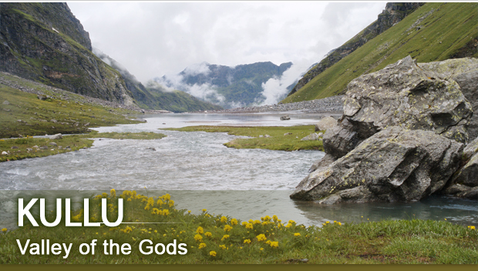
Introduction
Kullu or Kulu is the capital town of the Kullu district in the Indian state of Himachal Pradesh. It is located on the banks of the Beas River in the Kullu Valley about 10 kilometres (6.2 mi) north of the airport at Bhuntar.

Slide 42

Our Sponser

Slide 43
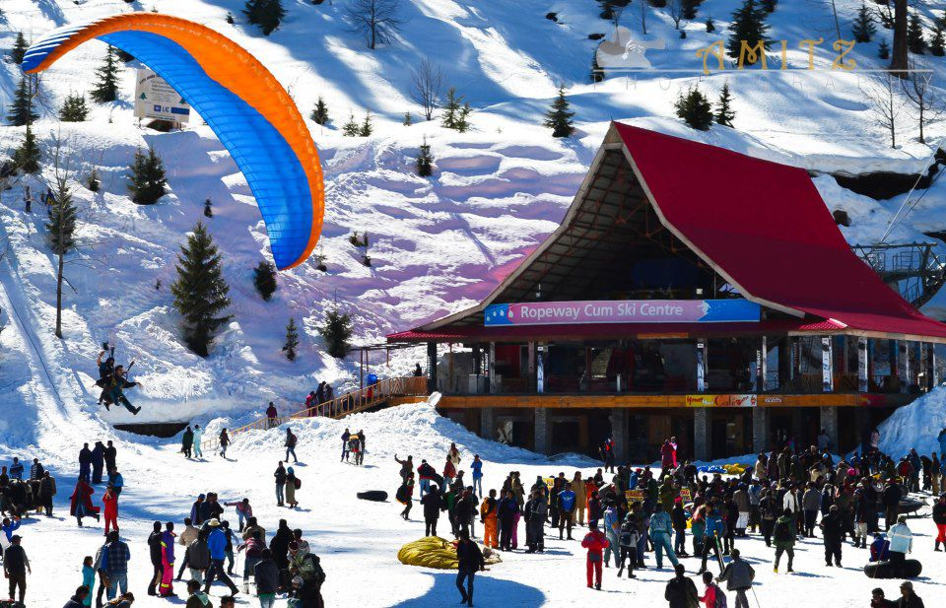
Solang(Kullu)
Famous for its ski slopes and latest state of the art ropeway.Solang is a beautiful valley with enchanting views of snow capped mountains, thick conifer forest, lush green meadows and a meandering river. It is host to a spectrum of adventure activities and one can indulge in sports like skiing, snow boarding and paragliding and can also experience adventure activities like hiking, camping, traversing, snow mobiling, zorbing, mountain biking, quad riding, horse riding and many more.

Slide 44
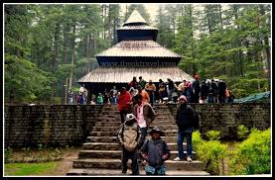
Hadimba Temple(Kullu)
Famous for its ski slopes and latest state of the art ropeway.Solang is a beautiful valley with enchanting views of snow capped mountains, thick conifer forest, lush green meadows and a meandering river. It is host to a spectrum of adventure activities and one can indulge in sports like skiing, snow boarding and paragliding and can also experience adventure activities like hiking, camping, traversing, snow mobiling, zorbing, mountain biking, quad riding, horse riding and many more.

Slide 45
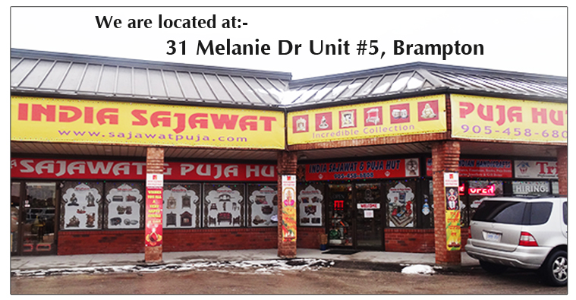
Our Sponser

Slide 46
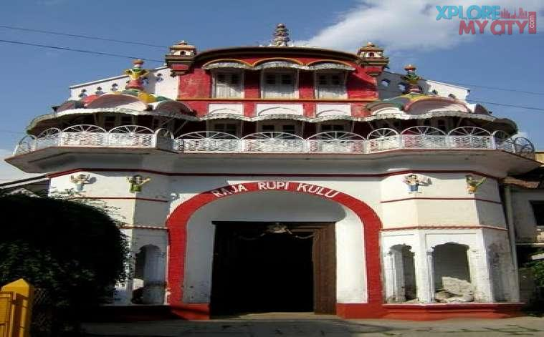
Sultanpur Palace(Kullu)
The Sultanpur Palace is one of the major tourist attractions in Kullu and houses some beautiful miniature paintings made in a marvelous blend of Pahari and colonial style based on different themes. These paintings show the simple rural backgrounds of the local people of Kullu & Manali with human figures in them. This palace was formerly called the Rupi Palace, which was damaged in an earthquake and was later reconstructed through its remnants.

Slide 47
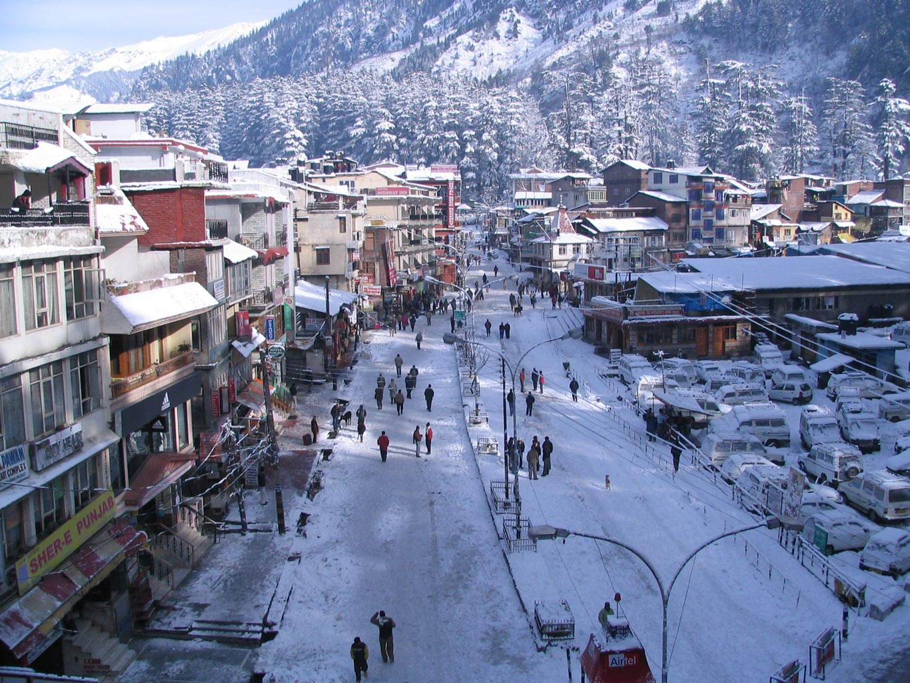
Manali
Manali is a Valley nestled in the mountains of the Indian state of Himachal Pradesh near the northern end of the Kullu Valley, at an altitude of 2,050 m (6,726 ft) in the Beas River Valley. It is located in the Kullu district, about 270 km (168 mi) north of the state capital, Shimla, 309 km (192 miles) northeast of Chandigarh and 544 km (338 miles) northeast of Delhi.

Slide 48

Our Sponser

Slide 49
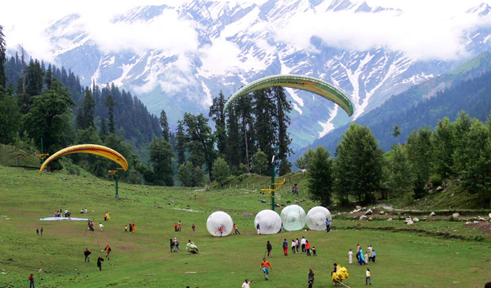
Solang Velly(Manali)
Solang Valley is quiet and is best approached by road. The drive up to Solang is extremely picturesque. Once you are there, try out some Chinese food from the local roadside shacks, and enjoy the views. The road ahead is blocked since a tunnel to Koksar (a village ahead of Rohtag La) is now being built there One of the most fascinating aspects of Manali is the fact that it has several colourful monasteries.

Slide 50

Our Sponsers

Slide 51
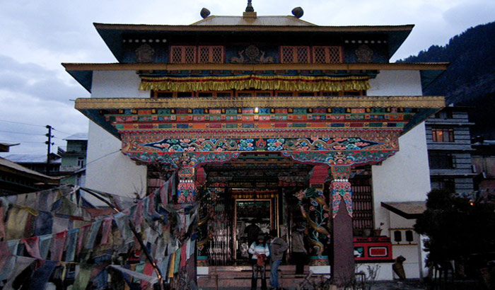
Tibetan Monestries(Manali)
The two most important monasteries that draw a huge number of tourists to Manali from across the globe are the Gadhan Thekchoking Gompa and the Himalayan Nyingamapa Gompa. You can shop for beautiful handicrafts that are made by Tibetan people at these monasteries.

Slide 52

Our Sponser

Slide 53

Our Sponser

Slide 54


Slide 55


